Slide 1


Teamwork Platform
A Flutter-Based Collaboration Tool
Presented by: Group 3

Slide 2
Project Overview
Goal:
To build a cross-platform Flutter application for real-time collaboration and project management, inspired by tools like Trello.
Key Features:
Create and manage boards, lists, and tasks
Real-time team collaboration
Visual project tracking
Multi-workspace support

Slide 3
Target Users
Students managing coursework
Teams working on projects
Startups needing simple task tracking

Slide 4
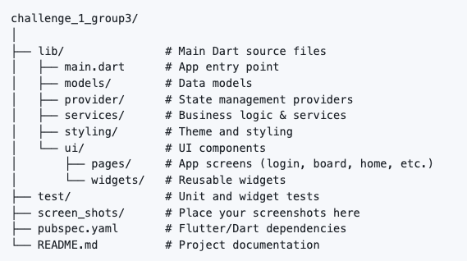
Project Structure

Slide 5
Core Features Breakdown
Task Management
• Boards → Lists → Cards (like Trello)
Team Collaboration
• Shared access, real-time updates
Workspace Management
• Organize tasks by teams/projects
Progress Visualization
• Easily track task completion

Slide 6
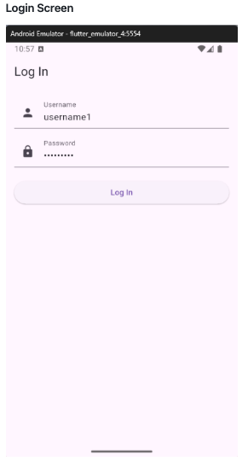
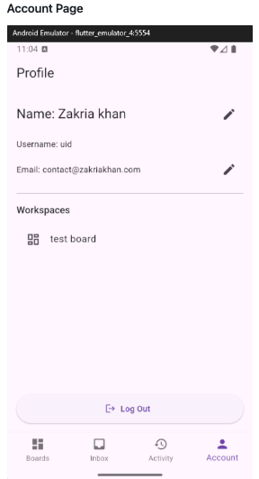
Features: User Authentication
Login / Signup system
Personalized user dashboard

Slide 7
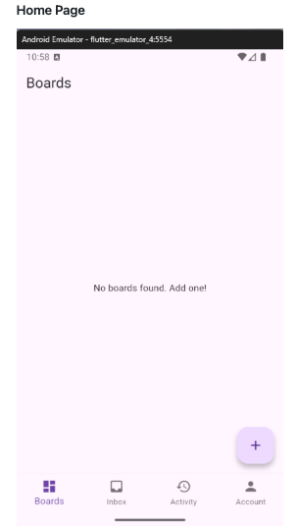
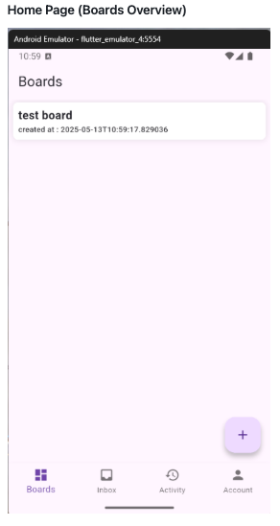
Features: Task Management
Create Boards
Users can create boards for different projects
Each board can contain multiple lists and tasks

Slide 8
Features: Task Management
Add Lists and Tasks
Lists act as workflow stages (e.g., To Do, In Progress, Done)
Tasks can include name, description, deadlines, assignees

Slide 9
Features: Team Collaboration
Shared access
Access via Account Page
Change username, email, profile info
Real-time updates
Tasks update instantly across devices
Provider used for efficient state management

Slide 10
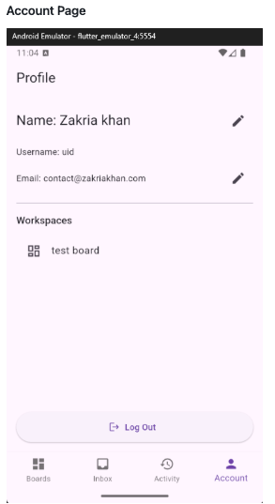
Features: Workspace Management
Organize boards under workspaces
Ideal for users managing multiple teams

Slide 11
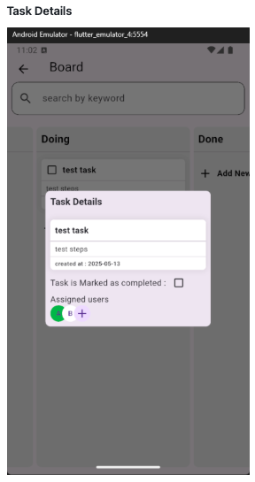
Features: Progress Visualization
Easily track task completion
Tap on any task to view or edit details

Slide 12
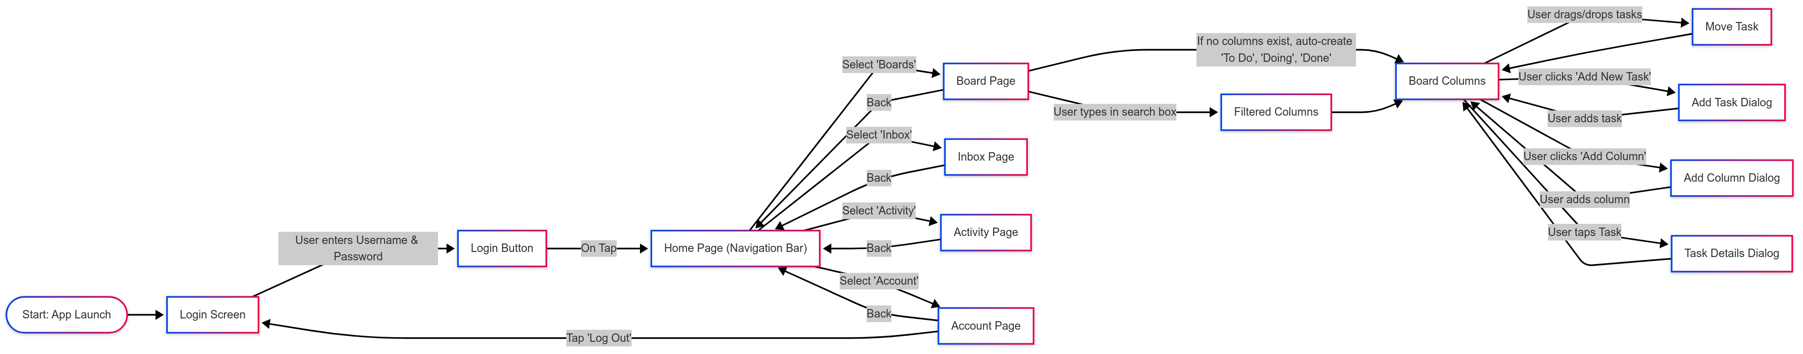
Flow Chart

Slide 13
Next Steps & Future Features
Firebase real-time database
Task deadline reminders
Kanban drag-and-drop UI
Team chat and notifications

Slide 14
Live Demo

